Slide 1
Restaurant Location Analysis
Divyanshi Paliwal
October 1, 2019

Slide 2
Business Problem
People in Delhi are fond of food and love to try different cuisines or restaurants; this is why on every street of Delhi, one can find a restaurant or a street-food vendor
As a restaurant owner, it is important to identify a suitable location to open a restaurant to maintain the customers and ensure profitability
An ideal location can ensure visibility of the restaurant, which is important to attract customers, and helps in maintaining the supply for the raw materials
Objective
To identify a suitable location for a restaurant, it is important to have information on the places available, cuisines and type of restaurants
Interest
The analysis is of interest to restaurant chains and restaurant owners who want to open a new restaurant in Delhi-NCR and aim to identify suitable location and what type of restaurant will work for the location.

Slide 3
Data Acquisition and cleaning
The data used in the project has been taken from one of the publically available Zomato Dataset on Kaggle
Data downloaded has records of restaurants throughout India. Since the study focuses only on Delhi-NCR, the data was filtered to serve the need.
About 6000 rows of data was left after filtering
Redundant data, data irrelevant to the analysis was dropped.
Some data was formatted in the required way, for example – Features available in a restaurant was modified to the number of features.
After cleaning, data containing 11 columns and about 6000 rows was obtained.

Slide 4
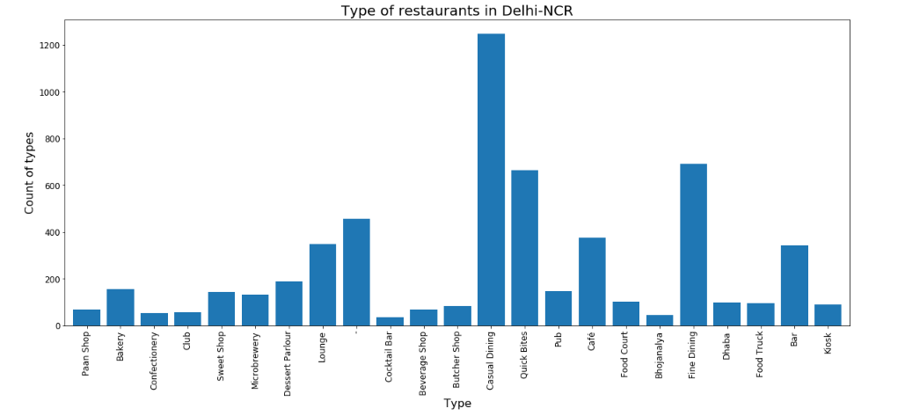
Types of restaurants in Delhi-NCR
The bar plot above shows that in Delhi-NCR, Casual Dining is the most popular type of restaurant, followed by Fine Dining and Quick Bites.

Slide 5
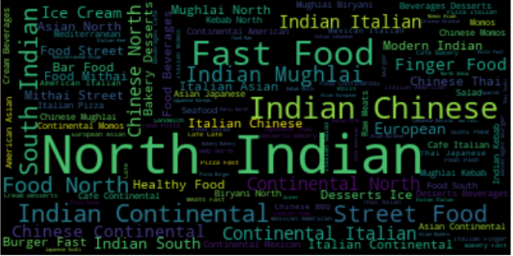
Popular cuisines in Delhi-NCR
The world cloud shows that North Indian cuisine is preferred by the people in the region. Delhi-NCR is a region in the northern part of India, hence the liking for North Indian food seems apt.
Fast Food and Indian Chinese are other cuisines which are preferred by the people, which means that many restaurants provide these cuisines

Slide 6
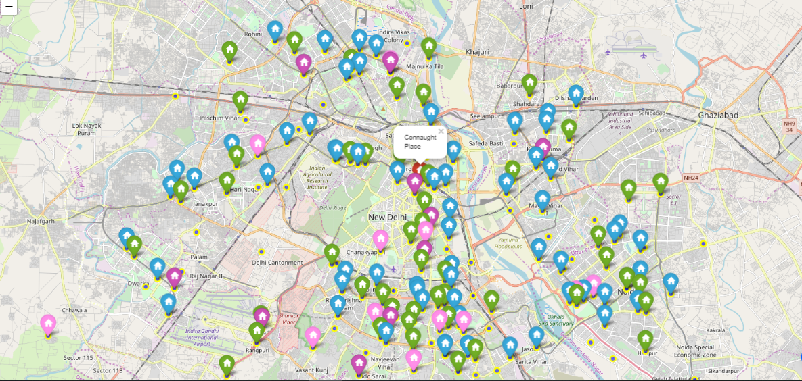
Locations and respective footfalls
As can be seen from the map, there is only one ‘Red’ marker, which is for the locality – Connaught Place. On further analysis, it was found that Connaught Place has more than 13,00,000 recorded footfalls. This means that people tend to go to Connaught Place a lot as compared to other regions.

Slide 7
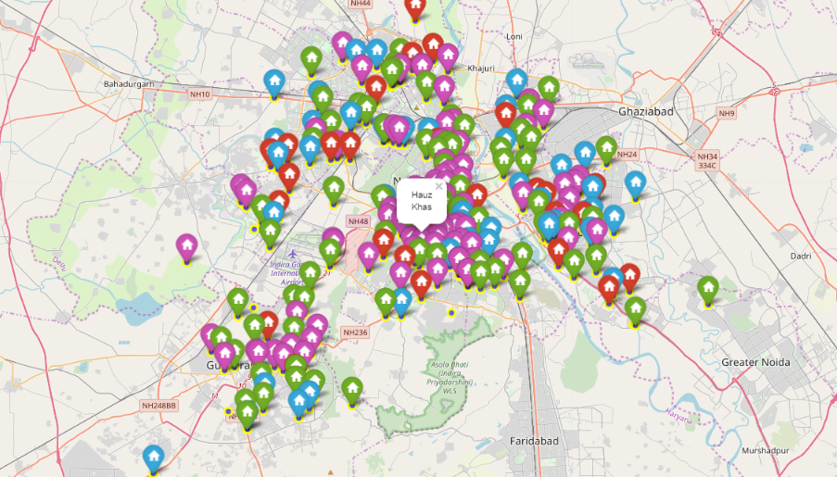
Locations with high rated restaurants
From the above map, it can be inferred that in regions in and around southern part of Delhi, there restaurants are have high average ratings and a lot of ‘Purple’ marker can be seen crowding the space. The southern part of Delhi has low number of low rated restaurant localities

Slide 8
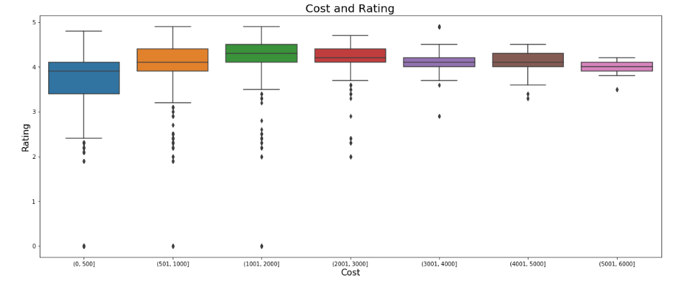
Impact of Cost on Ratings
By looking at the box plot it can be inferred that the ideal range of cost is between 1000-2000 as the ratings have increased till that point and as the cost increased beyond 2000 for two, the ratings have seen a decline

Slide 9
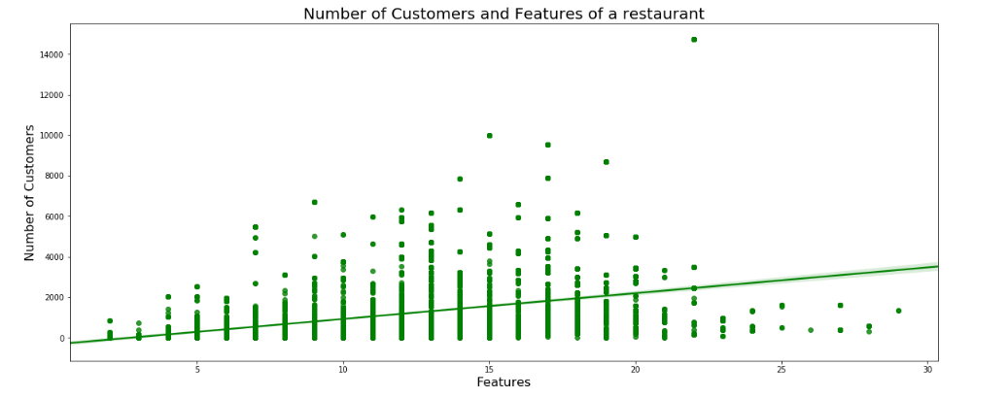
Relation between features and footfall
The correlation statistics for the parameter are -
From both the chart and the value of correlation coefficient, it can be inferred that there is no strong correlation between the two parameters, but the p-value is less than 0.01, therefore, relation between the two cannot be disregarded altogether. Hence, number of features play a limited role in attracting customers.

Slide 10
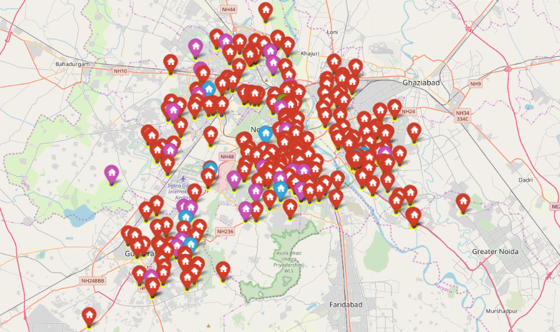
Clustering and Further Analysis - Forming Clusters
‘Red’ : cluster 1
‘Blue’ : cluster 2
‘Green’ : cluster 3
‘Purple’ : cluster 4
From the above map, it can be seen that cluster 1 is the densely populated cluster with many locations clustered together. Cluster 3 has only one location, which is Connaught Place.

Slide 11
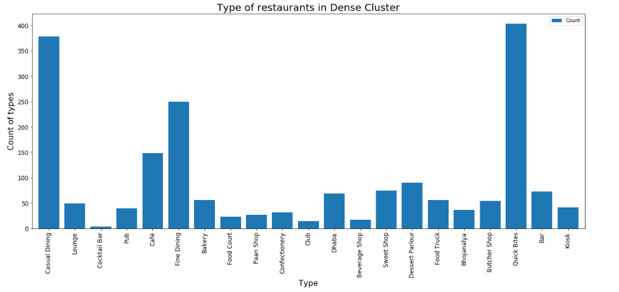
Clustering and Further Analysis -Dominant restaurant types in densely populated cluster
From the graph, it can be observed that the most dominant restaurant type in cluster 1 (densely populated cluster) is Quick Bites, followed by Casual Dining and Fine Dining

Slide 12
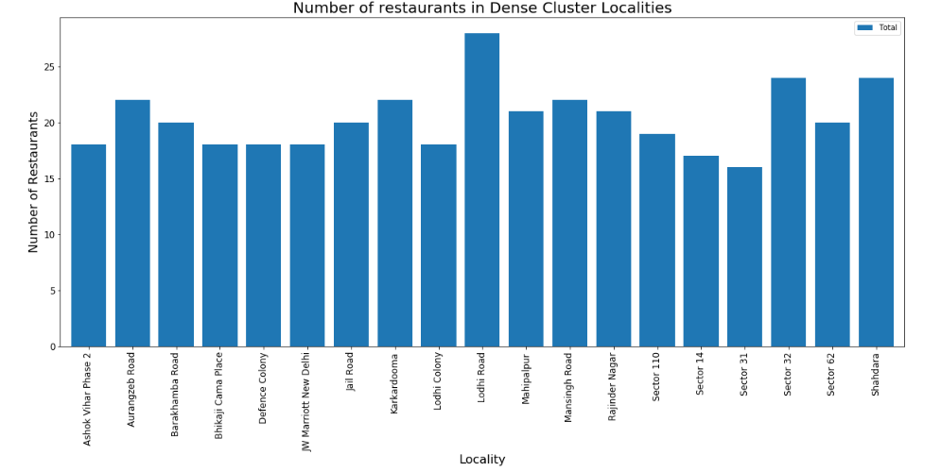
Clustering and Further Analysis -Locations with highest number of restaurant in identified restaurant types
From the graph, Lodhi Road has the highest number of restaurants in the identified restaurant types, followed by Sector 32 and Shahdara.

Slide 13
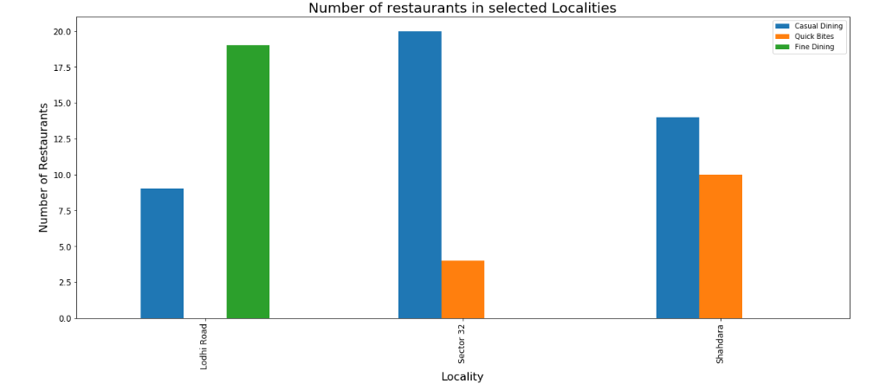
Clustering and Further Analysis -Type of restaurants are common in identified locations
From the above figure, it is observed that in Lodhi Road, Fine Dining is the preferred restaurant type. This is because, Lodhi Road is a posh area and people there prefer a luxury dining experience. In Sector 32 of Noida, Casual Dining is preferred, but in Shahdara both Casual and Quick Bites are preferred, Casual Dining a little more than Quick Bites, this is because in Shahdara middle-income population thrives who would prefer an economical casual dining.

Slide 14
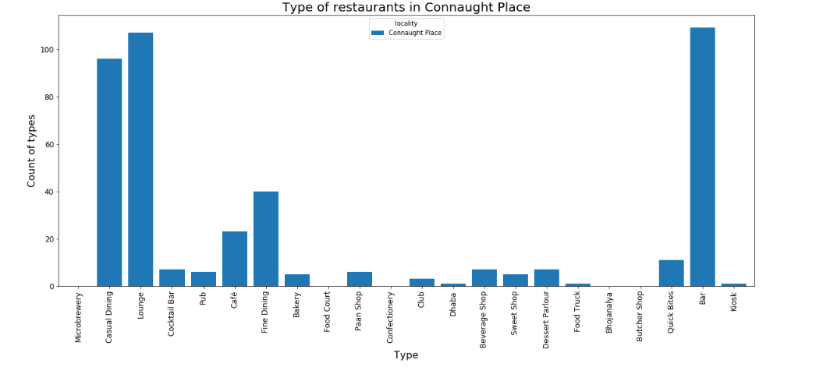
Clustering and Further Analysis -A different case – Connaught Place
The above graph shows that Connaught Place will be an ideal location if one wants to open a Bar or a Lounge. Alcohol and music is probably the reason why the footfalls in Connaught Place is so high!

Slide 15
Conclusions and Discussions
To open a restaurant ideal place will be Lodhi Road if the type of restaurant to be opened is Fine Dining as the people in the region are high-incomed and prefer fine dining. If choice of restaurant is Casual Dining then either Sector 32, Noida or Connaught Place are better option than others. To open is a lounge or a bar, then Connaught Place is the best place
It is advisable to keep the cost between Rs. 1000- Rs. 2000 for two to make dining affordable but selective.
The restaurant can opt to serve North Indian, along with Chinese, Continental or Italian, since these are clearly identifiable in the word cloud shown before
The clustering was performed on only one criteria, different criteria such as proximity to each other or based on cuisine, the locations could have been clustered
If data related to reviews for each restaurant could be arranged, it would have been possible to identify the popular dish in a location
Selecting a location for a restaurant also depends on the land available, price of acquiring that land and other miscellaneous charges, a data related to such parameters would have helped in a proper analysis.

Slide 16
THANK YOU!

